Slide 1

Perancangan Sistem Pemrograman
GRASP: Designing Objects with Responsibilities
Prepared by Frans Panduwinata, S.Kom, M.T

Slide 2

GRASP: A Methodical Approach to Basic OO Design
The GRASP principles or patterns are a learning aid to help you understand essential object design and apply design reasoning in a methodical, rational, explainable way.
This approach to understanding and using design principles is based on patterns of assigning responsibilities.

Slide 3
Responsibility
Responsibility: a contract or obligation of a type or class.
Two types of responsibilities:
  Knowing
    Knowing about private encapsulated data
    Knowing about related objects
    Knowing about things it can derive or calculate
  Doing
    Doing something itself
    Initiating action in other objects
    Controlling and coordinating activities in other objects

Slide 4
Responsibility (cont)
Responsibilities are assigned to classes of objects during object design.
For EXAMPLE,
I may declare that "a Sale is responsible for creating SalesLineItems" (a doing), or "a Sale is responsible for knowing its total" (a knowing).

Slide 5
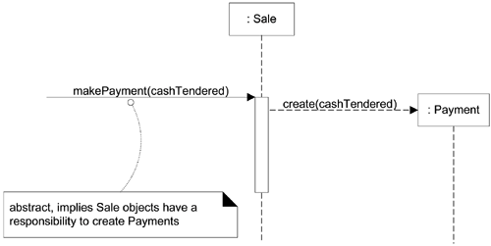
Responsibilities, GRASP, and UML Diagrams
What's the Connection Between Responsibilities, GRASP, and UML Diagrams?
The figure above indicates that Sale objects have been given a responsibility to create Payments, which is concretely invoked with a makePayment message and handled with a corresponding makePayment method.

Slide 6
Patterns
Principles and idioms in a structured format describing the problem and solution.
In OO design, a pattern is
a named problem/solution pair that can be applied in new context, with advice on how to apply it in various situations.

Slide 7
Patterns (cont)
For EXAMPLE, here is a sample pattern:
Pattern Name: Information Expert
Problem: What is a basic principle by which to assign responsibilities to objects?
Solution: Assign a responsibility to the class that has the information needed to fulfill it.

Slide 8
Patterns (cont)
Patterns have names, such as Information Expert and Abstract Factory.
Naming a pattern, design idea, or principle has the following advantages:
  It supports chunking and incorporating that concept into our understanding and memory.
  It facilitates communication.

Slide 9
Applying GRASP to Object Design
GRASP stands for General Responsibility Assignment Software Patterns.
GRASP patterns describe fundamental principles of assigning responsibilities to objects, expressed as patterns.
There are nine GRASP patterns.

Slide 10
Applying GRASP to Object Design (cont)
First five GRASP patterns:
  Creator,
  Information Expert,
  Low Coupling,
  Controller ,
  High Cohesion

Slide 11
Creator
Problem
Who should be responsible for creating a new instance of some class?
  The creation of objects is one of the most common activities in an object-oriented system.
  Consequently, it is useful to have a general principle for the assignment of creation responsibilities.
  Assigned well, the design can support low coupling, increased clarity, encapsulation, and reusability.

Slide 12
Creator (cont)
Solution
  Assign class B the responsibility to create an instance of class A if one of these is true (the more the better):
    B "contains" or compositely aggregates A.
    B records A.
    B closely uses A.
    B has the initializing data for A that will be passed to A when it is created. Thus B is an Expert with respect to creating A.
  B is a creator of A objects.

Slide 13
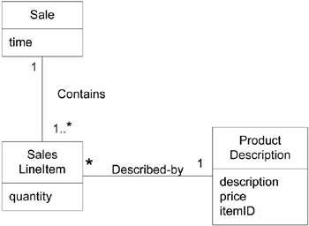
Creator (cont)
EXAMPLE:
  In the NextGen POS application, who should be responsible for creating a SalesLineItem instance?
  By Creator, we should look for a class that aggregates, contains, and so on, SalesLineItem instances.

Slide 14
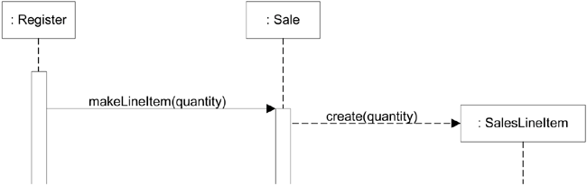
Creator (cont)
EXAMPLE: (cont)
  Since a Sale contains many SalesLineItem objects, the Creator pattern suggests that Sale is a good candidate to have the responsibility of creating SalesLineItem instances.
  This leads to the design of object interactions shown below.

Slide 15
Creator (cont)
Benefits
  Low coupling is supported, which implies lower maintenance dependencies and higher opportunities for reuse.
  Coupling is probably not increased because the created class is likely already visible to the creator class, due to the existing associations that motivated its choice as creator.

Slide 16
Information Expert (or Expert)
Problem
What is a general principle of assigning responsibilities to objects?
  A Design Model may define hundreds or thousands of software classes, and an application may require hundreds or thousands of responsibilities to be fulfilled.
  During object design, when the interactions between objects are defined, we make choices about the assignment of responsibilities to software classes.
  If we've chosen well, systems tend to be easier to understand, maintain, and extend, and our choices afford more opportunity to reuse components in future applications.

Slide 17
Information Expert (cont)
Solution
Assign a responsibility to the information expert the class that has the information necessary to fulfill the responsibility.
EXAMPLE:
  In the NextGEN POS application, some class needs to know the grand total of a sale.
  So, Who should be responsible for knowing the grand total of a sale?
  By Information Expert, we should look for that class of objects that has the information needed to determine the total.

Slide 18
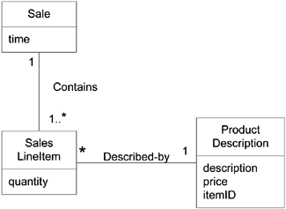
Information Expert (cont)
EXAMPLE: (cont)
  What information do we need to determine the grand total?
  We need to know about all the SalesLineItem instances of a sale and the sum of their subtotals.
  A Sale instance contains these; therefore, Sale is a suitable class of object for this responsibility; it is an information expert for the work.

Slide 19

Information Expert (cont)
EXAMPLE: (cont)
  A partial interaction diagram and class diagram in figure below illustrate some decisions.
  We are not done yet. What information do we need to determine the line item subtotal?
    SalesLineItem.quantity and ProductDescription.price.
    The SalesLineItem knows its quantity and its associated ProductDescription; therefore, SalesLineItem should determine the subtotal; it is the information expert.

Slide 20
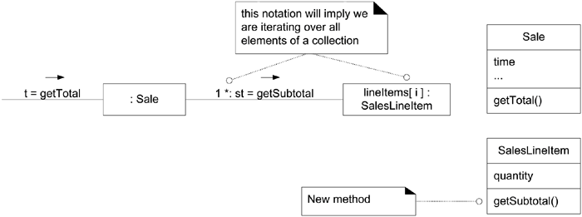
Information Expert (cont)
EXAMPLE: (cont)
  In terms of an interaction diagram, this means that the Sale should send getSubtotal messages to each of the SalesLineItems and sum the results

Slide 21
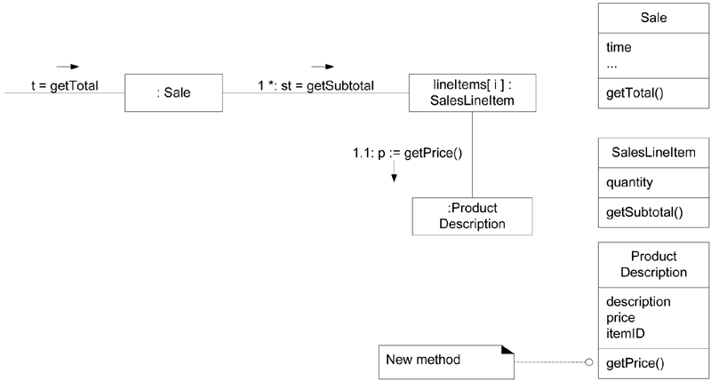
Information Expert (cont)
EXAMPLE: (cont)
  To fulfill the responsibility of knowing and answering its subtotal, a SalesLineItem has to know the product price.
  The ProductDescription is an information expert on answering its price; therefore, SalesLineItem sends it a message asking for the product price.

Slide 22
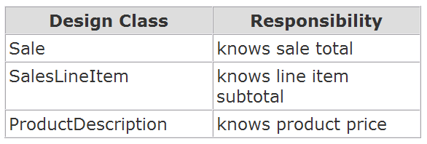
Information Expert (cont)
EXAMPLE: (cont)
  In conclusion, to fulfill the responsibility of knowing and answering the sale's total, we assigned three responsibilities to three design classes of objects as follows.

Slide 23
Information Expert (cont)
Benefits
  Information encapsulation is maintained since objects use their own information to fulfill tasks.
  Supports low coupling, which leads to more robust and maintainable systems.
  High cohesion is usually supported. Behavior is distributed across the classes that have the required information, thus encouraging more cohesive "lightweight" class definitions that are easier to understand and maintain.

Slide 24
Low Coupling
Problem
How to support low dependency, low change impact, and increased reuse?
  Coupling is a measure of how strongly one element is connected to, has knowledge of, or relies on other elements.
  An element with low (or weak) coupling is not dependent on too many other elements.
  These elements include classes, subsystems, systems, and so on.

Slide 25
Low Coupling (cont)
Problem
How to support low dependency, low change impact, and increased reuse? (cont)
  A class with high (or strong) coupling relies on many other classes.
  Such classes may be undesirable; some suffer from the following problems:
    Forced local changes because of changes in related classes.
    Harder to understand in isolation because they depend on others classes for example.
    Harder to reuse because its use requires the additional presence of the classes on which it is dependent.

Slide 26
Low Coupling (cont)
Solution
Assign a responsibility so that coupling remains low. Use this principle to evaluate alternatives.
EXAMPLE:
  Consider the following partial class diagram from a NextGen case study:

Slide 27
Low Coupling (cont)
EXAMPLE: (cont)
  We need to create a Payment instance and associate it with the Sale. What class should be responsible for this?
  Since a Register "records" a Payment in the real-world domain, the Creator pattern suggests Register as a candidate for creating the Payment.
  The Register instance could then send an addPayment message to the Sale, passing along the new Payment as a parameter.

Slide 28
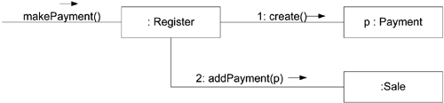
Low Coupling (cont)
EXAMPLE: (cont)
  This assignment of responsibilities couples the Register class to knowledge of the Payment class.
  Note that the Payment instance is explicitly named p so that in message 2 it can be referenced as a parameter.

Slide 29
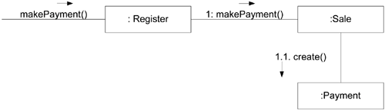
Low Coupling (cont)
EXAMPLE: (cont)
  An alternative solution to creating the Payment and associating it with the Sale.

Slide 30
Low Coupling (cont)
Which design, based on assignment of responsibilities, supports Low Coupling?
  In both cases we assume the Sale must eventually be coupled to knowledge of a Payment.
  Design 1, in which the Register creates the Payment, adds coupling of Register to Payment;
  Design 2, in which the Sale does the creation of a Payment, does not increase the coupling. Purely from the point of view of coupling, prefer Design 2 because it maintains overall lower coupling.
  This example illustrates how two patterns Low Coupling and Creator may suggest different solutions.

Slide 31
Low Coupling (cont)
Benefits
  Not affected by changes in other components
  Simple to understand in isolation
  Convenient to reuse

Slide 32
Controller
Problem
What first object beyond the UI layer receives and coordinates ("controls") a system operation?
  System operations are the major input events upon our system. For example,
    When a cashier using a POS terminal presses the "End Sale" button, he is generating a system event indicating "the sale has ended."
    Similarly, when a writer using a word processor presses the "spell check" button, he is generating a system event indicating "perform a spell check."
  A controller is the first object beyond the UI layer that is responsible for receiving or handling a system operation message.

Slide 33
Controller (cont)
Solution
Assign the responsibility to a class representing one of the following choices:
  Represents the overall "system," a "root object," a device that the software is running within, or a major subsystem.
  Represents a use case scenario within which the system event occurs, often named <UseCaseName>Handler, <UseCaseName>Coordinator, or <UseCaseName>Session (use case or session controller).

Slide 34
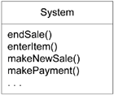
Controller (cont)
EXAMPLE:
The NextGen application contains several system operations.

Slide 35
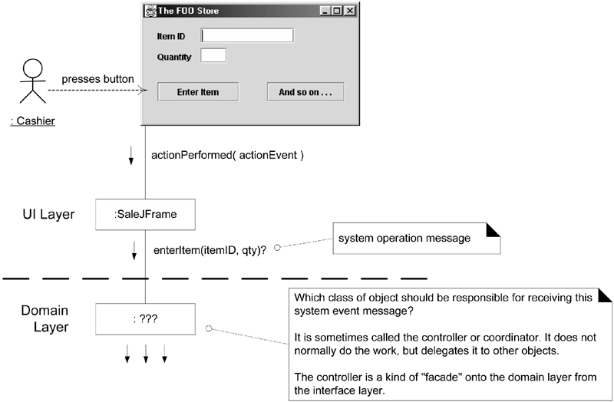
Controller (cont)
EXAMPLE: (cont)

Slide 36
Controller (cont)
EXAMPLE: (cont)
  Who should be the controller for system events such as enterItem and endSale?
  By the Controller pattern, here are some choices:
  Represents the overall "system," Register, POSSystem
  "root object," device, or subsystem.
  Represents a receiver or handler of ProcessSaleHandler,
  all system events of a use case scenario. ProcessSaleSession

Slide 37
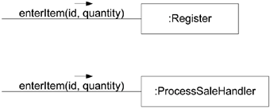
Controller (cont)
EXAMPLE: (cont)
  Controller choices.

Slide 38
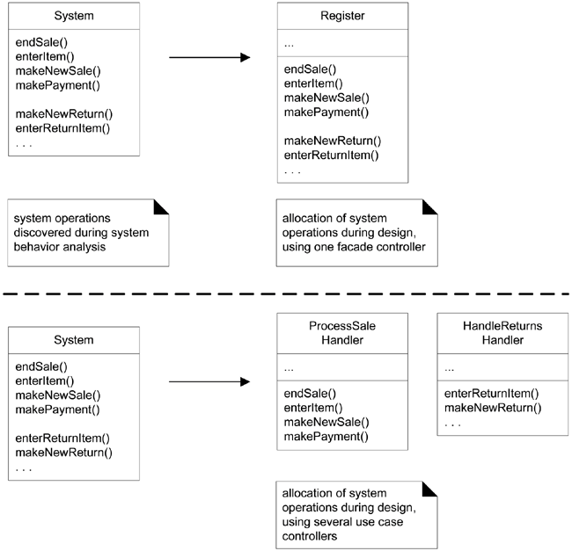
Controller (cont)
EXAMPLE: (cont)
  Allocation of
  system operations.

Slide 39
Controller (cont)
Benefits
  Increased potential for reuse and pluggable interfaces
    Ensure that application logic is not handled in the interface layer.
    An interface-as-controller design reduces the opportunity to reuse logic in future applications, since logic that is bound to a particular interface (for example, window-like objects) is seldom applicable in other applications.
    By contrast, delegating a system operation responsibility to a controller supports the reuse of the logic in future applications.
    And since the application logic is not bound to the interface layer, it can be replaced with a different interface.

Slide 40
Controller (cont)
Benefits (cont)
  Opportunity to reason about the state of the use case
    Sometimes we must ensure that system operations occur in a legal sequence, or we want to be able to reason about the current state of activity and operations within the use case that is underway.
    For EXAMPLE,
    We may have to guarantee that the makePayment operation cannot occur until the endSale operation has occurred. If so, we need to capture this state information somewhere; the controller is one reasonable choice, especially if we use the same controller throughout the use case

Slide 41
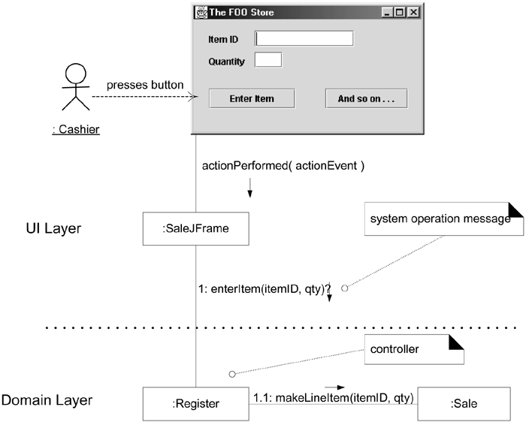
Controller (cont)
Desirable coupling of UI layer to domain layer.

Slide 42
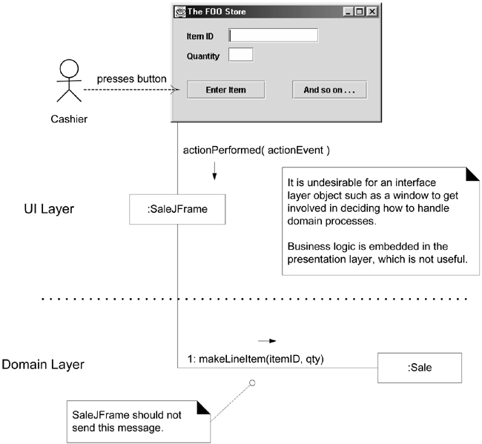
Controller (cont)
Less desirable coupling of interface layer to domain layer.

Slide 43
High Cohesion
Problem
How to keep objects focused, understandable, and manageable, and as a side effect, support Low Coupling?
  In terms of object design, cohesion is a measure of how strongly related and focused the responsibilities of an element are.
  An element with highly related responsibilities that does not do a tremendous amount of work has high cohesion.
  These elements include classes, subsystems, and so on.

Slide 44
High Cohesion (cont)
Solution
Assign a responsibility so that cohesion remains high. Use this to evaluate alternatives.
  A class with low cohesion does many unrelated things or does too much work. Such classes are undesirable; they suffer from the following problems:
    hard to comprehend
    hard to reuse
    hard to maintain
    delicate; constantly affected by change
  Low cohesion classes often represent a very "large grain" of abstraction or have taken on responsibilities that should have been delegated to other objects.

Slide 45
High Cohesion (cont)
EXAMPLE:
  Assume we have a need to create a (cash) Payment instance and associate it with the Sale. What class should be responsible for this?
  Since Register records a Payment in the real-world domain, the Creator pattern suggests Register as a candidate for creating the Payment.
  The Register instance could then send an addPayment message to the Sale, passing along the new Payment as a parameter,

Slide 46
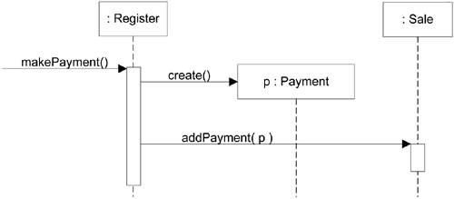
High Cohesion (cont)
EXAMPLE: (cont)
  The Register is taking on part of the responsibility for fulfilling the makePayment system operation.

Slide 47
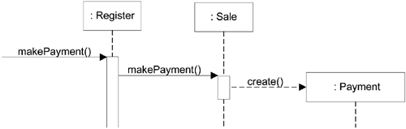
High Cohesion (cont)
EXAMPLE: (cont)
  In this isolated example, this is acceptable; but imagine fifty system operations, all received by Register. If Register did the work related to each, it would become a "bloated" incohesive object.
  By contrast, as shown in figure below, the second design delegates the payment creation responsibility to the Sale supports higher cohesion in the Register.

Slide 48
High Cohesion (cont)
Some scenarios that illustrate varying degrees of functional cohesion:
  Very low cohesion
  A class is solely responsible for many things in very different functional areas.
  Low cohesion
  A class has sole responsibility for a complex task in one functional area.

Slide 49
High Cohesion (cont)
Some scenarios that illustrate varying degrees of functional cohesion: (cont)
  High cohesion
  A class has moderate responsibilities in one functional area and collaborates with other classes to fulfill tasks.
  Moderate cohesion
  A class has lightweight and sole responsibilities in a few different areas that are logically related to the class concept but not to each other.

Slide 50
High Cohesion (cont)
Benefits
  Clarity and ease of comprehension of the design is increased.
  Maintenance and enhancements are simplified.
  Low coupling is often supported.
  Reuse of fine-grained, highly related functionality is increased because a cohesive class can be used for a very specific purpose.

